Slide 1
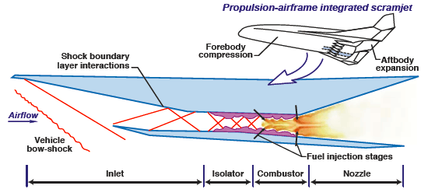
ISOLATOR By Deependra and Ankit
Notes:
In this presentation, we will talk about what we have understood from the research paper “Scramjet Isolators” by Professor Michael K. Smart, University of Queensland, Australia.

Slide 2
Function of Isolator
to avoid the propagation of disturbances generated by heat release in combustor to the upstream of fuel injection
A short length of duct (isolator) is usually added to the scramjet flow path upstream of the combustor to contain the flow separation phenomenon and stop it from disrupting the operation of the inlet.
Notes:
Combustion of fuel with the incoming air generates a large local pressure rise and separation of the boundary layer on the surfaces of the combustor duct.
This separation which can feed upstream of the point of fuel injection, acts to further compress the core flow by generating a series of shock waves known as a shock-train.

Slide 3
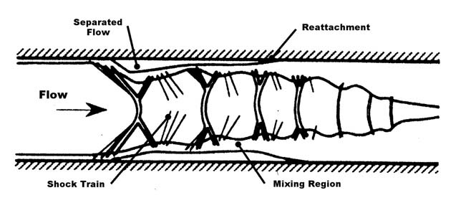
Geometry of Isolator
There is a series of bifurcated curved shock waves inside an isolator.
The flow separates due to large adverse pressure gradient caused by shock train.
Notes:
The flow reattaches as it goes downstream because it is a tendency of turbulent boundary layer to be attached to walls and occupy whole duct.

Slide 4

EMPERICAL CORRELATION BETWEEN SHOCK TRAIN LENGTH AND PRESSURE RISE
In 1970s, Waltup and Biling developed the following emperical correlation:
s = shock train length, M = mach number,
D = duct diameter, delta_P = pressure rise
θ = momentum thickness
= Reynolds number based on theta

Slide 5
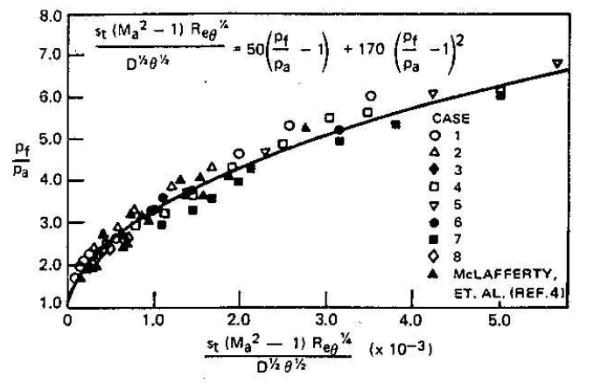
By varying incoming (to isolator inlet) Mach numbers between 1.5 and 2.7, they made the following experimental plot.
Notes:
p_f is the pressure behind shock train, p_a = pressure ahead of shock train
The different cases are for different Mach numbers between 1.5 and 2.7.

Slide 6
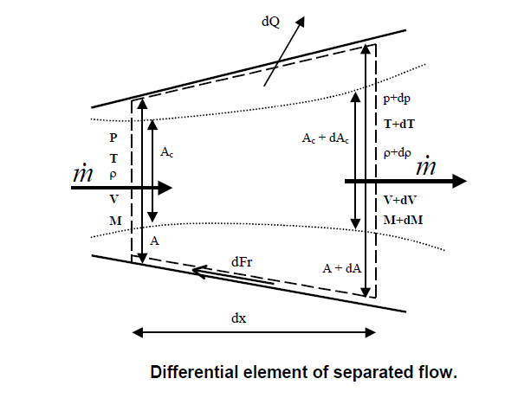
ONE DIMENSIONAL FLOW ANALYSIS
Notes:
Ac is the ‘core flow area’ and A is ‘duct area’.

Slide 7
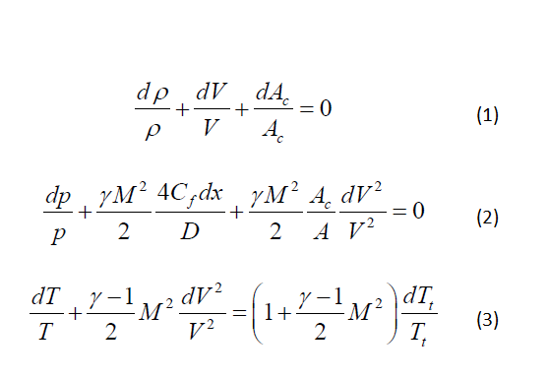
The differential conservation equations are:
Notes:
Derivations for equations 2 and 3 will be done on white board.
These 3 equations are the differential forms of the conservation of mass, momentum and energy respectively.

Slide 8


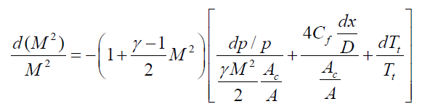
The equation of state and the definition of Mach
number in differential form are:
(equation of state) (4)
(from M=V/a) (5)
After some algebraic manipulations of equations 2, 3 and 5, we get
(6)
Notes:
Equation 6 will be derived on white board.

Slide 9

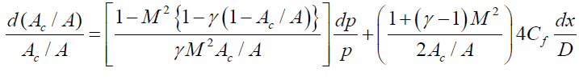

The following equations were taken (by M. Smart) from other research papers.
(Ortwerth’s diffuser
relation; emperical)
Equation 8 is for the ratio of ‘core flow area’ to ‘duct area’.
Notes:
Ac is the ‘core flow area’ and A is ‘duct area’.

Slide 10
The change in total enthalpy of the flow through element (in Slide 6) is
(9)
where = heat of combustion,
= stoichiometric fuel to air ratio
φ = equivalence ratio for fuel
= heat loss to the structure
Using equations (1) – (9), some initial conditions and assumptions, Michael Smart et al. got a plot of axial variations of various flow properties (using some standard ODE solver).
Notes:
The plot is given on the next page.

Slide 11
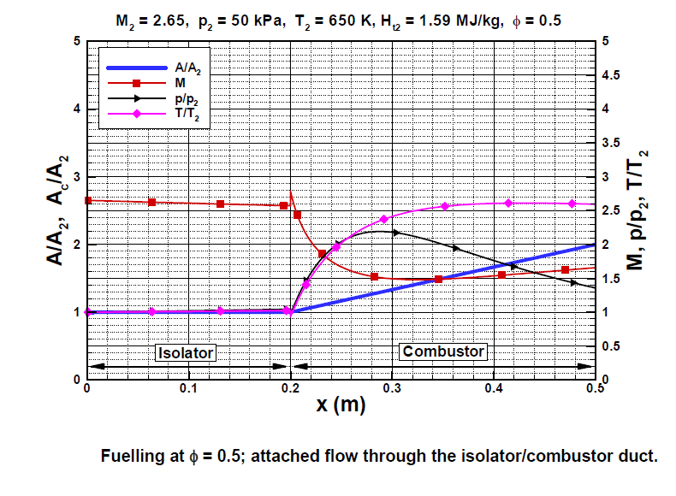
Notes:
Station 2 is the entry of the isolator.
Station 3 is the start of combustor.
Station 4 is the end of combustor.

Slide 12
THANK YOU
By
Deependra and Ankit
Notes:
THANK YOU!

